Slide 1






10th Annual
SD Colorectal
Cancer
Roundtable
10 YEARS OF PROGRESS IN COLORECTAL CANCER SCREENING
Tuesday, February 27th

Slide 2


Audio
Make sure your line is muted during the roundtable
Roundtable
Reminders
Zoom Chat
Use the chat to introduce yourself & ask questions throughout the session
Roundtable Recording
Slides, recording and resources will be shared with all attendees

Slide 3


Today’s Agenda
Welcome!
10 Years of Colorectal Cancer Screening in San Diego: How Far We’ve Come & The Road Ahead
Changing Epidemiology of Colorectal Cancer: What’s Going On and What Can We Do?
FQHC Case Studies
CA CRC Coalition (C4) Advocacy Updates and Grants/Medi-Cal Expansion
Closing & Next Steps

Slide 4
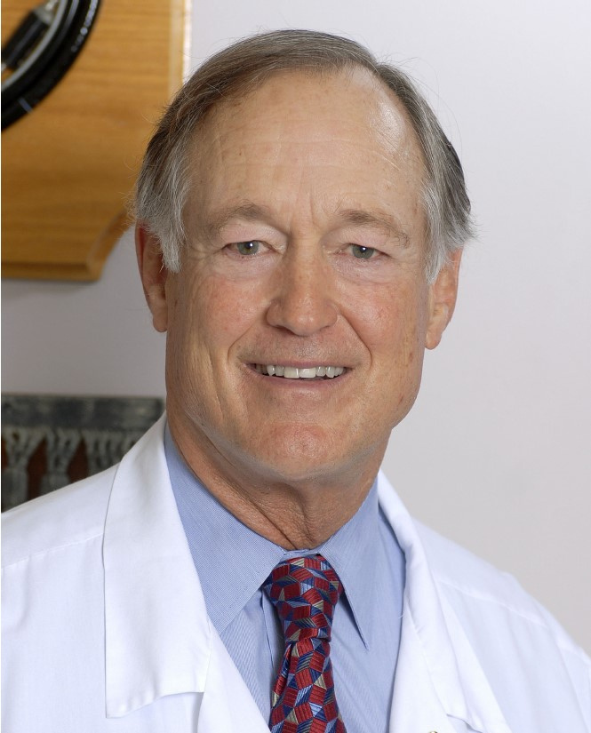
Daniel Stonewall Anderson, MD, MACP
California Colorectal Cancer Coalition
Welcome & 10 Years of Colorectal Cancer Screening in San Diego: How Far We’ve Come & The Road Ahead

Slide 5
Welcome to the Tenth Annual San Diego Colorectal Cancer Roundtable
10 years of Increasing Screening and Decreasing Incidence of Colorectal Cancer
Daniel S. Anderson MACP
President Board of Directors (C4)
February 27, 2024

Slide 6
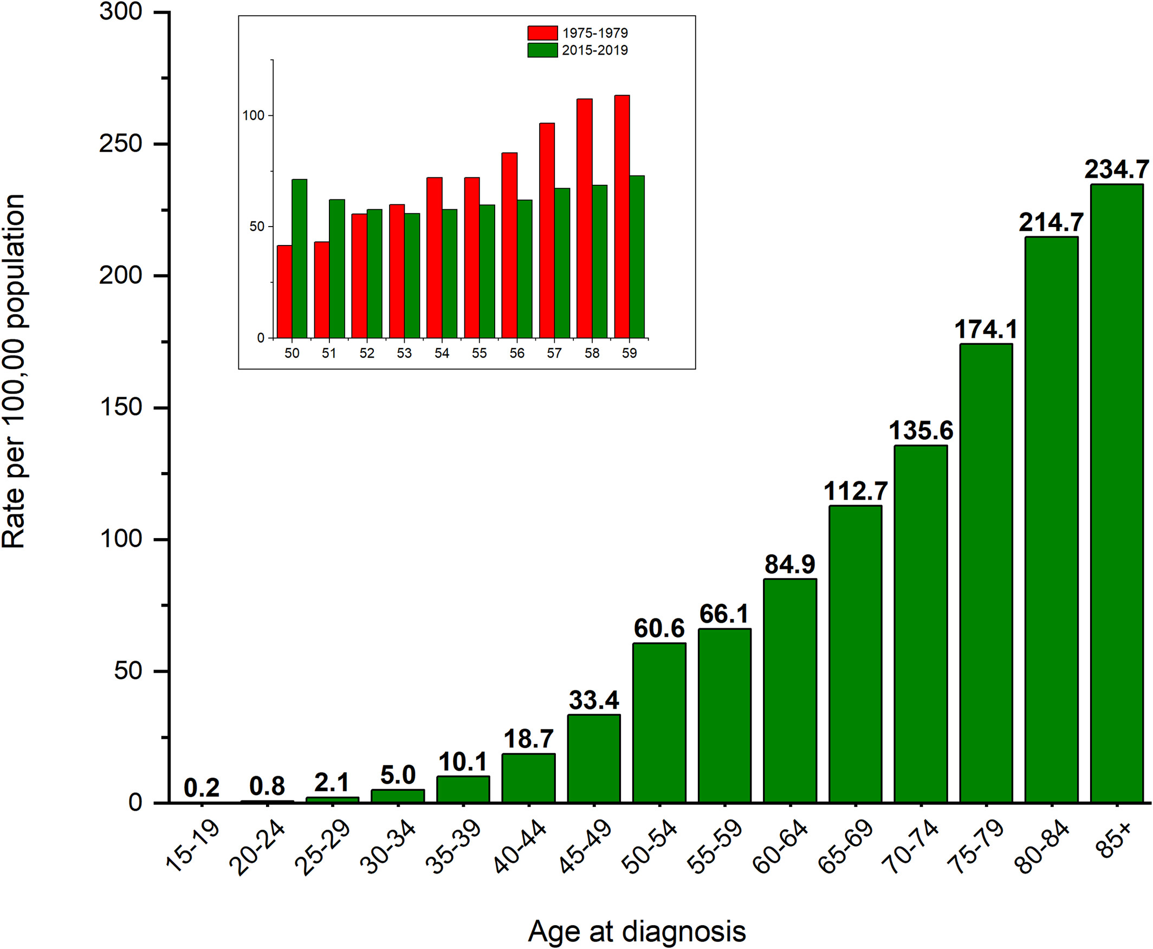
Colorectal cancer statistics, 2023
CA A Cancer J Clinicians, Volume: 73, Issue: 3, Pages: 233-254, First published: 01 March 2023, DOI: (10.3322/caac.21772)
Notes:
Age‐specific colorectal cancer incidence rates, 2015–2019, United States. Incidence rates exclude appendiceal cancer and are age‐adjusted to the 2000 US standard population. Source: Main figure: North American Association of Central Cancer Registries, 2022; Inset: Surveillance, Epidemiology, and End Results Program, 2022.
IF THIS IMAGE HAS BEEN PROVIDED BY OR IS OWNED BY A THIRD PARTY, AS INDICATED IN THE CAPTION LINE, THEN FURTHER PERMISSION MAY BE NEEDED BEFORE ANY FURTHER USE. PLEASE CONTACT WILEY'S PERMISSIONS DEPARTMENT ON PERMISSIONS@WILEY.COM OR USE THE RIGHTSLINK SERVICE BY CLICKING ON THE 'REQUEST PERMISSIONS' LINK ACCOMPANYING THIS ARTICLE. WILEY OR AUTHOR OWNED IMAGES MAY BE USED FOR NON-COMMERCIAL PURPOSES, SUBJECT TO PROPER CITATION OF THE ARTICLE, AUTHOR, AND PUBLISHER.

Slide 7
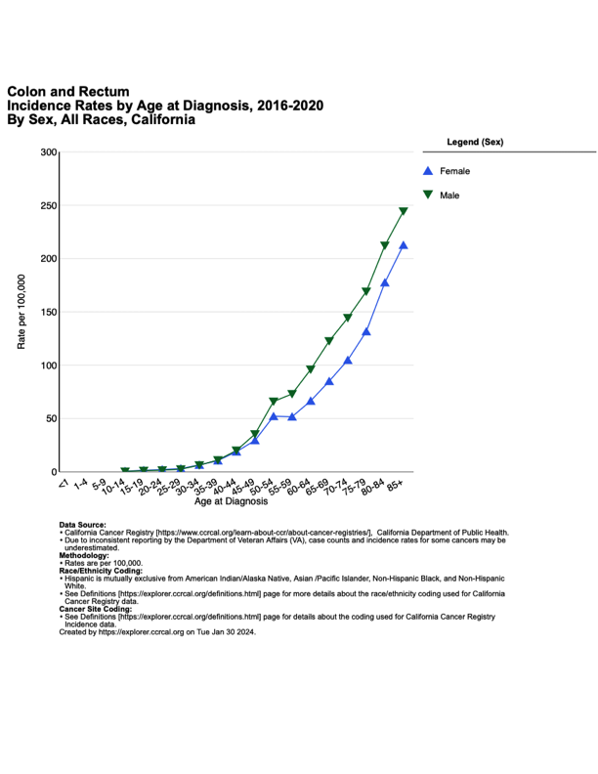

Slide 8
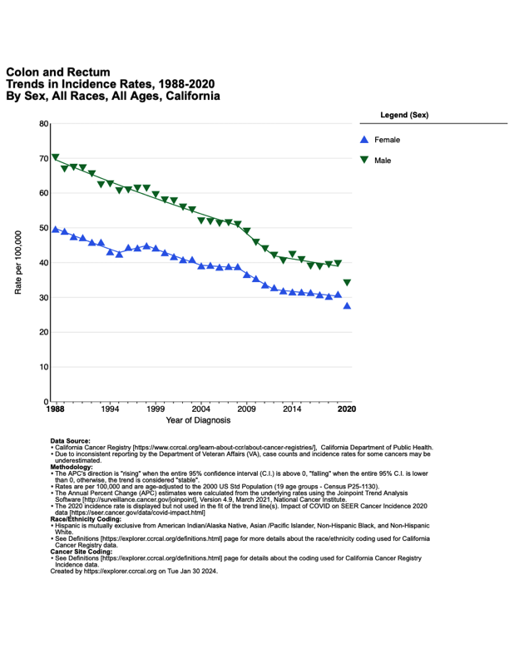

Slide 10
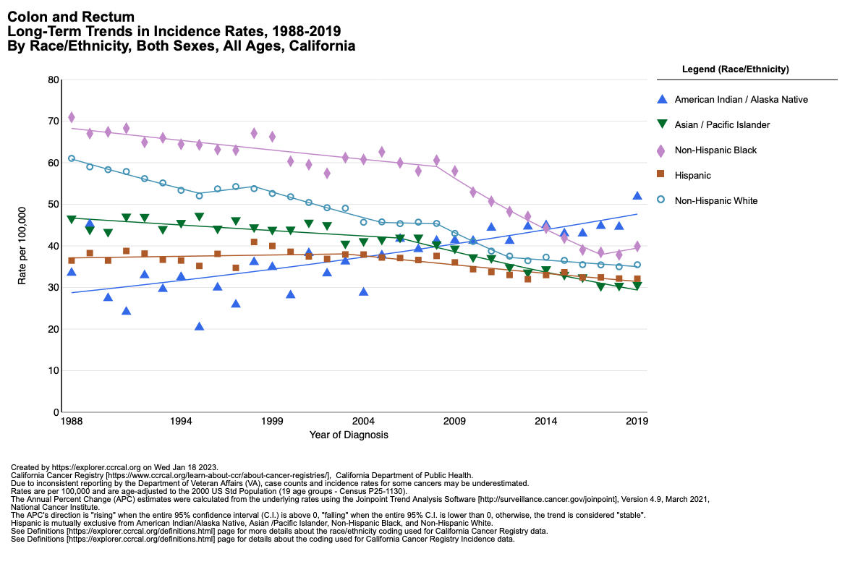

Slide 11
Overall Percent Change in CRC Incidence:
California, 1988 - 2019
Race/Ethnicity | Males |  | Females
White, non-Latino | -47 % | ↓ | -39 % | ↓
African American | -44 % | ↓ | -46 % | ↓
Latino | -15 % | ↓ | -10 % | ↓
Asian/Pacific Islander | -38 % | ↓ | -30 % | ↓
Native American | 42 % | ↑ | 57 % | ↑

Slide 13
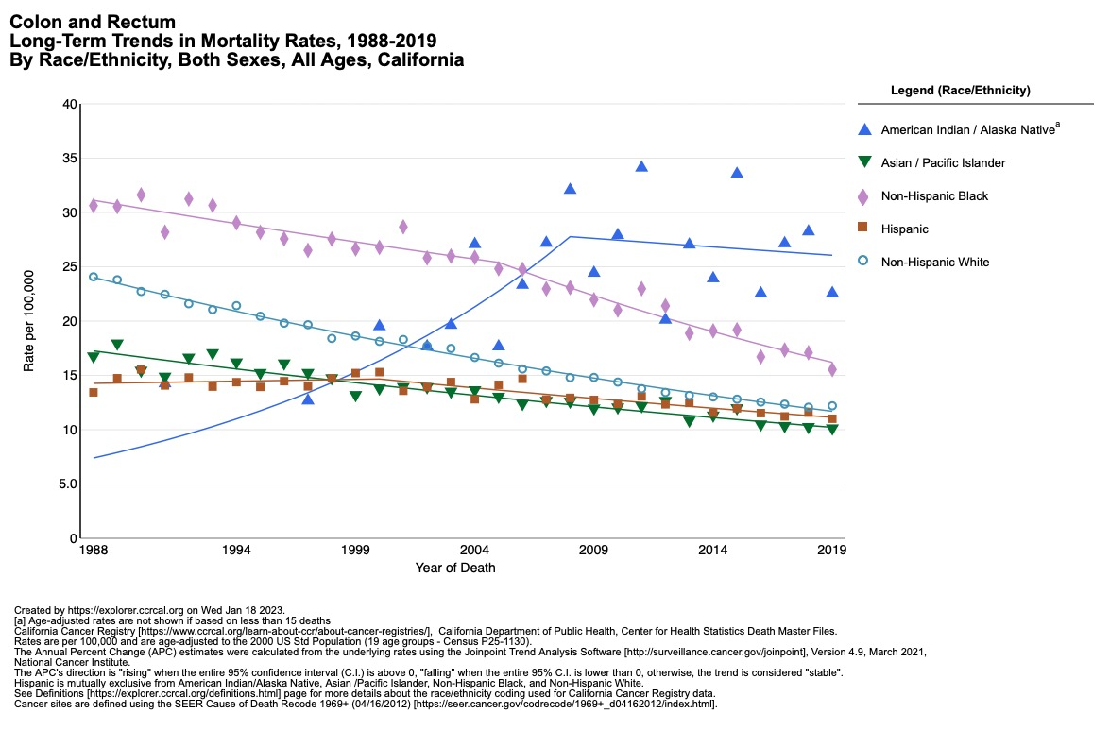

Slide 14
Overall Percent Change in CRC Mortality:
California, 1988 - 2019
Race/Ethnicity | Males |  | Females
White, non-Latino | -53 % | ↓ | -47 % | ↓
African American | -42 % | ↓ | -55 % | ↓
Latino | -13 % | ↓ | -22 % | ↓
Asian/Pacific Islander | -43 % | ↓ | -37 % | ↓
Native American | 114 % | ↑ | 196 % | ↑

Slide 15
San Diego Compared To
California and the USA
Rate per 100,000 age-adjusted 2016-20 from CCR
San Diego California USA
Incidence: 33.2 33.5 36.5
Trend - 0.3% - 1.1% - 1.1 %
Mortality: 11.7 12.1 13.1
Trend -2.1% (429) -2.1 (5333) -1.9% (51,819)
https://explorer.ccrcal.org https://statecancerprofiles.cancer.gov/index.html

Slide 16
Cancer Statistics 2023 Estimated Deaths California
Lung and Bronchus 9,380
Colon and Rectum 5,530
Pancreas 4,970
Breast 4,680
Prostate 4,090

Slide 17
How Well is San Diego Screening for Colorectal Cancer?
Using the California Office of Patient Advocate https://www.opa.ca.gov/reportcards/Pages/default.aspx
Using Uniform Data Systems Measures from the HRSA website https://data.hrsa.gov/tools/data-reporting/program-data
Not using Survey Data

Slide 18
California Screening Rates from OPA.GOV 2021 and 2022 Health Plans Rates
2022 rates are age 45 to 75 2021 2022
Kaiser North and South 76% 69%
Sharp Health Plan 74% 63%
Health Net HMO 69% 58%
Anthem Blue Cross HMO 67% 58%
Blue Shield California HMO 66% 57%
CIGNA HMO 64% 55%
United Health Care 63% 55%

Slide 19
California Screening Rates from OPA.GOV 2021 age 50 to 75
Medical Groups San Diego County
UC San Diego Health 79%
Kaiser 76%
Sharp Rees-Stealy 73%
Sharp Medical Group IPA 70%
Scripps Medical Group 62%
Palomar Health Medical Group 63%
Primary Care Associates MG 64%
Mercy Physicians MG 54%

Slide 20
California Screening Rates from OPA.GOV 2021 age 50-75
Medicare San Diego County
Kaiser San Diego 88%
UC San Diego Health 83%
Sharp Rees-Stealy 82%
Primary Care Associates Medical Group 78%
Sharp Community Medical Group IPA 75%
Scripps Clinic 68%
Mercy Physicians Medical Group 73%
Scripps Physician Medical Group 71%
Palomar Health Medical Group 67%

Slide 23
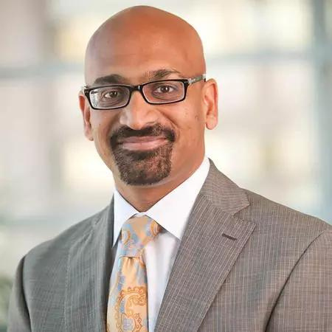
Samir Gupta, MD, MSCS, AGAF
Moores Cancer Center at University of California, San Diego
Changing Epidemiology of Colorectal Cancer: What’s Going On and What Can We Do?

Slide 24
The changing epidemiology of colorectal cancer: what’s going on and what can we do?
Samir Gupta, MD, MSCS
Professor of Medicine, Division of Gastroenterology, UC San Diego
Staff Physician, VA San Diego Healthcare System
s1gupta@health.ucsd.edu

Slide 25
The epidemiology of colorectal cancer (CRC) is changing, due to birth cohort effects
A birth cohort effect is when an outcome, such as incident CRC, is strongly determined by year of birth
Birth cohorts age through life and share exposures
  Historical events
  Social experiences
  Socio-economic factors
  Environmental exposures
Example: social media use based on exposure to evolving technologies and platforms
  Baby Boomers born 1946 – 1964 more likely to use Facebook than other platforms
  Generation X born 1965 – 1979 also more likely to use Facebook than other platforms, less likely to share personal stuff
  Millennials born 1980 – 1995 heavily share on Instagram and some still Facebook, and often use for personal communication/sharing
  Gen Z born 1996 onwards more likely to use Instagram and Snapchat, consume content on YouTube, and use social media more often for entertainment than personal sharing
  Source: https://www.postbeyond.com/social-media-generations-2/

Slide 26
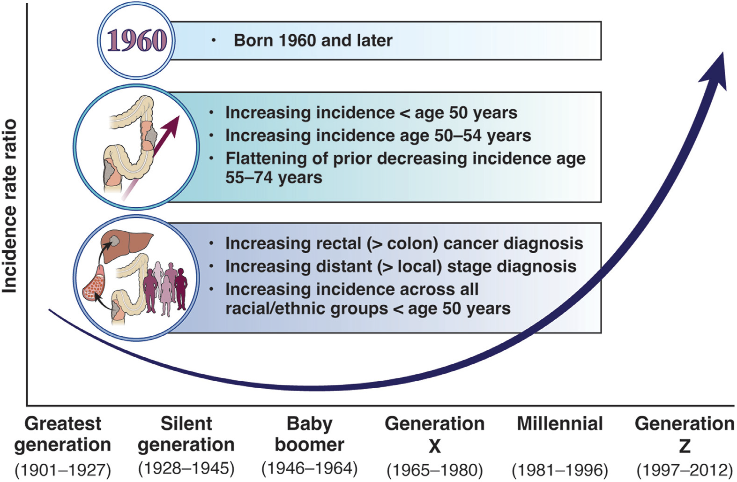
Birth Cohort CRC

Slide 27
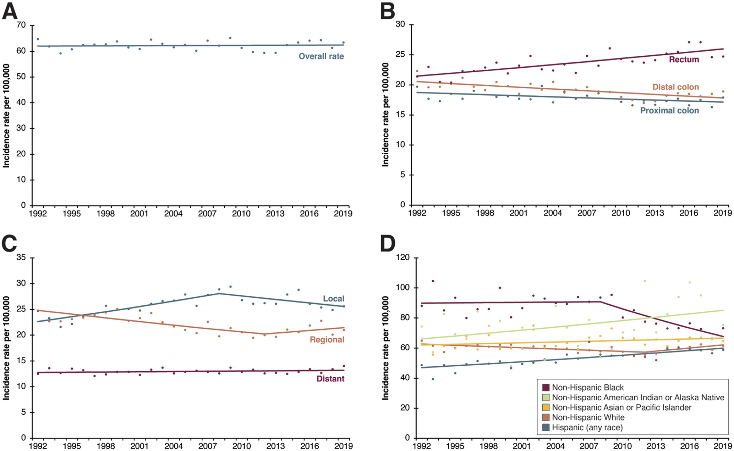
Example changes: Age 50-59

Slide 28
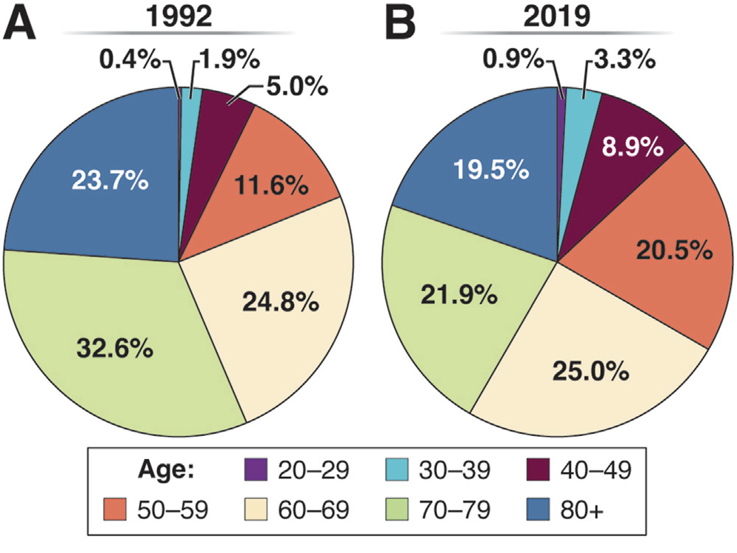
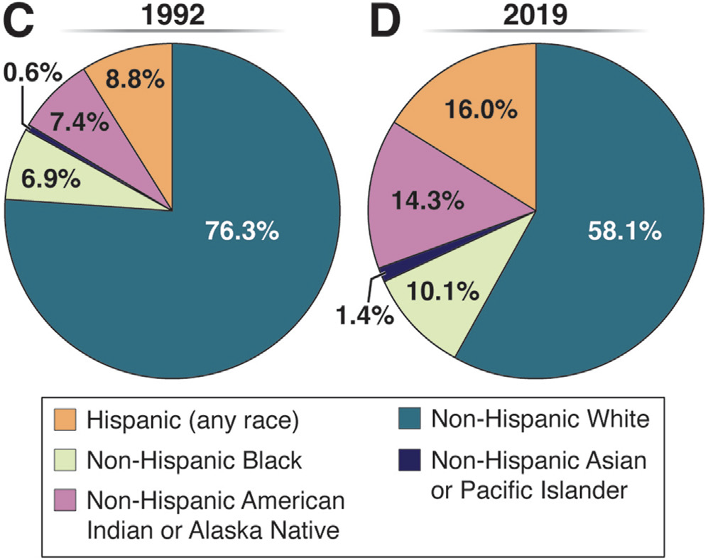
Changes are impacting who gets CRC

Slide 29
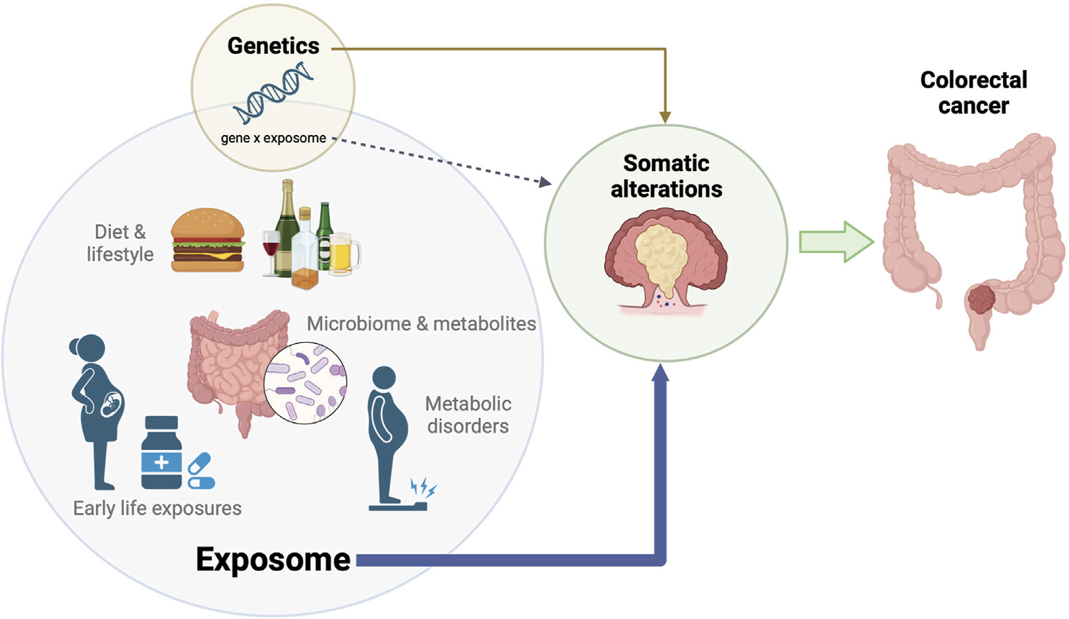
Causes require more research

Slide 30
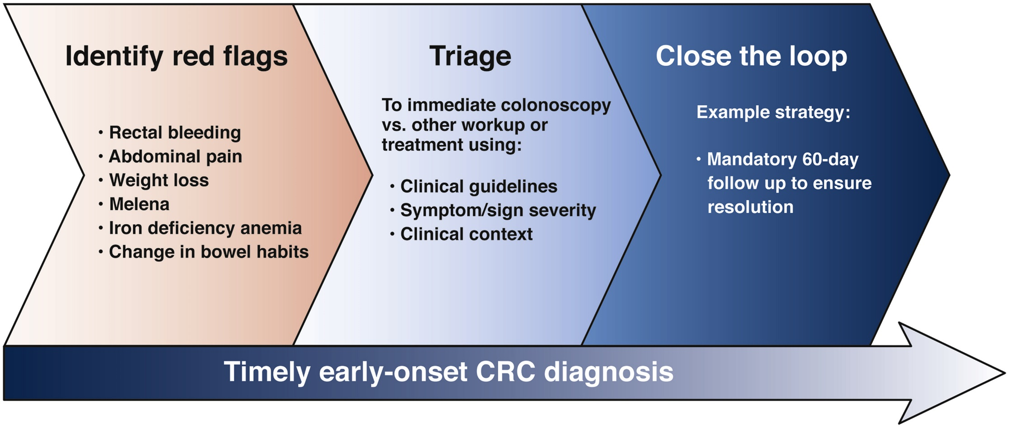
What can we do now?
Individuals under age 45
  Close the clinical loop on potential red-flag signs and symptoms of CRC
  Measure and act on family history
    Among those with family history and CRC <age 50, if guidelines had been applied:
      82% could have been diagnosed earlier
      67% had CRC prevented
Individuals age >45 age eligible for screening
  ↑ Urgency to get people up to date
Stanich Gastro 2021; Burnett Hartman; A Demb; J Lee JK; Gupta S Gastro 2021; Siegel CA J Clin 2023

Slide 31
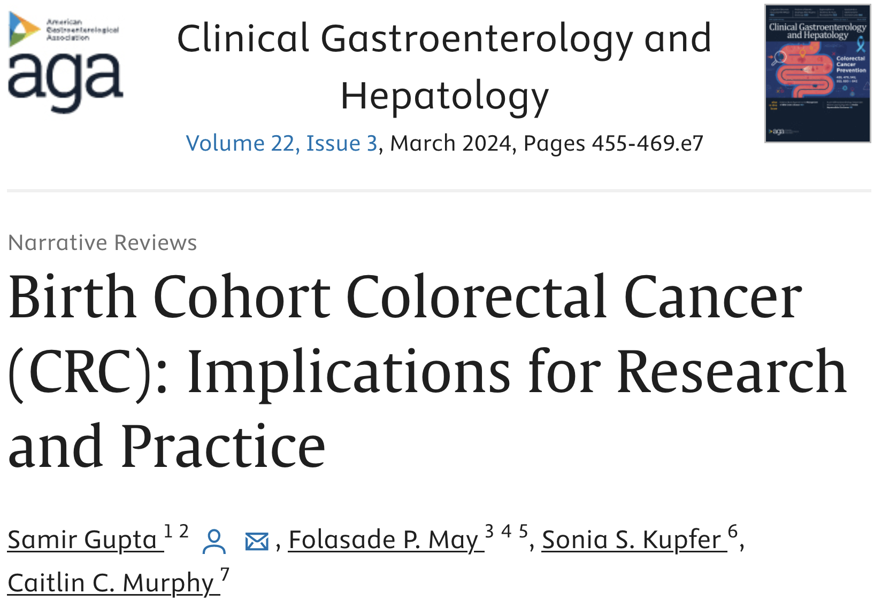
Thank you!
  Grant Support:
    NCI UG3 CA233314 01A1 (Martinez, Gupta, Castaneda, Roesch MPI)
    Cancer Center Support Grant CA023100-32
    NCI U54 CA132379 CA132384 (Martinez; Madanat)
    American Cancer Society RSG-17-232-01-CPPB (Nodora)
    NCI R37 CA222866 (Gupta)
  Birth Cohort CRC concepts: Drs. Folasade May, Sonia Kupfer, and Caitlin Murphy
  Contact: s1gupta@health.ucsd.edu

Slide 32

Neighborhood Healthcare
Federally Qualified Health Center Case Study
Progress in Colorectal Cancer Screening

Slide 33

Family Health Centers of San Diego
Federally Qualified Health Center Case Study
Progress in Colorectal Cancer Screening

Slide 34
Daniel Stonewall Anderson, MD, MACP
California Colorectal Cancer Coalition
CA CRC Coalition (C4) Advocacy Updates and Grants/Medi-Cal Expansion

Slide 35
California Colorectal Cancer Coalition (C4) Advocacy Update
C4 Grants Update
Medi-Cal Expansion Update
Daniel S. Anderson MACP
President Board of Directors (C4)
February 27, 2024

Slide 36
Objectives
Review changes to Medi-Cal that will impact CRC screening
Review where the California Department of Health Care Services is in reporting colorectal cancer screening rates for Medi-Cal Health Plans as an Adult Quality Core Measures in 2022
Discuss the next steps after health plans serving San Diego Medi-Cal patients are published
Review changes in Medi-Cal eligibility on FQHCs uninsured rate
Review the C4 Grants Program
Review the C4, CDOC, and CDHCS Grants Program

Slide 37
California’s Efforts Which Have Reduced California’s Uninsured Rate
Medi-Cal Expansion California in 2014
Medi-Cal Expansion to Undocumented Persons below age 27 in 2020
Assembly Bill (AB) 133 (Chapter 143, Statutes of 2021), Amended Welfare and Institutions Code Section 14007.8 to expand eligibility for full-scope Medi-Cal to individuals who are 50 years of age or older, regardless of citizenship or immigration status, if otherwise eligible. Expected to extend coverage to more than 185,000 individuals who are 50 years of age or older. Implementation date May 1, 2022

Slide 38
California’s Efforts Which Reduced California’s Uninsured Rate
The Final 2022 Budget approved the expansion of Medi-Cal eligibility to undocumented Californians age 26 to 49, effective on January 1, 2024
This provided insurance to an additional 700,000 Californians
Medi-Cal covered 15.5 million Californians in 2023
Sign-up rate in previous Medi-Cal expansions to the undocumented has been robust

Slide 39
Results of California’s Efforts to Decrease the Uninsured Population
California 2013=19% 2023=7.9%
California FQHCs 2010=43% 2022=15%
San Diego’s FQHCs 2010 2022
Vista 63% 18%
FH Centers 60% 32%
NHC 32% 13%
San Ysidro 52% 22%
SDFC 32% 11%
NCHP 43% 21%
hrsa.gov/uds/datacenter

Slide 40
Adding Colorectal Cancer (CRC) Screening to the California Medi-Cal Managed Care Accountability Set
FQHC’s Medical Director requested C4’s help in adding CRC screening to the Medi-Cal Quality Measures in 2016.
California was ready to add CRC screening to the required Medi-Cal Quality Measures in Spring of 2019 when Medic-Cal Managed Care shifted their Quality Measures to the CMS Medicaid Adult and Child Core Set of Quality Measures
Colorectal cancer screening was and is not a CMS Medicaid Adult Core Set Quality Measure in 2019.

Slide 41
Colorectal Cancer Screening Submitted for Addition in January
Made the Cut to be a Measure for Addition in April
Discussed and Voted on in May
In May, after voting member discussion, public comments in support allowed by phone
Samir Gupta C4 UCSD
Daniel Anderson C4
Rachel Issaka University of Washington
Heidi Bossley Am College of Gastroenterology
Molly McDonnell Fight Colorectal Cancer
Richard Wender NCCRT and University of Pennsylvania
Bev Green Kaiser Permanente Washington
Heather Davis New York State Department of Health
Caroline Powers ACS/CAN
Gloria Coronado Kaiser Permanente Oregon
Colorectal Cancer Screening Was Recommended for Addition by a
Unanimous Vote

Slide 42
Colorectal Cancer Screening Added to the CMS Adult Quality Core Measures Core Set in December 2021
Added CRC Screening to the California Medi-Cal Quality Measures in 2022
CRC Screening was a California Disparity Quality Measure in Medi-Cal in 2023
CRC Screening was added to the NCQA HEDIS Quality Measures in 2022
For more information go to the Gastroenterology OP-ED DOI:https://doi.org/10.1053/j.gastro.2021.12.253

Slide 43
Next Steps
Medi-Cal insurance carriers’ colorectal cancer 2022 screening rates will be reported in April 2024
Identify the insurance carriers which are poor performers in San Diego County
Set up training and interventions with these carriers.
Collaborating with Dr. Palav Babaria, Chief Quality Officer and Deputy Director of Quality And Population Health Management CA DHCS.

Slide 44
C4 Grants Program Overview
Grants given in California since 2013: $690,435 to 76 organizations
Grants given in San Diego County since 2013-2022: $285,000 to 7 FQHCs and Champions For Health
Recipients:
  Neighborhood Health Care
  Family Health Centers
  Champions For Health
  Vista Community Clinic
  St Vincent’s DePaul
  Operation Samahan
  San Ysidro
  Linda Vista Community Clinic

Slide 45

Breast & Colorectal Cancer Screening Implementation Project (BCCSIP) – Cycle I
Collaboration with Comprehensive Cancer, EWC and C4
Six FQHCs (EWC providers) selected through Merit Review Process
    The Achievable Foundation
    Bartz-Altadonna Community Health Center
    North East Medical Center (7 sites)
    Community Health Systems, Inc. (6 sites)
    Western Sierra Medical Clinic
    Gardner Health Services
7 months progress reports were due by January 31, 2024
Data reported will be 2023 complete data set, with 7 months of funding contributing toward changes in screening rates through implementation strategies
Read more on the CDOC website: cdoconline.net
Notes:
1:18 – 1:19 pm: Margaret

Slide 46
Breast & Colorectal Cancer Screening Implementation Project (BCCSIP)
Cycle II Funding
Merit review was completed at the end of November, 2023
Projects began January 1, 2024
Awarded $185,000 to 8 FQHC
  Bartz-Altadonna Community Health Center
  Coppertower Family Medical Center dba Alexander Valley Healthcare
  Gardner Family Health Network, Inc.
  Mission Neighborhood Health Center
  Operation Samahan, Inc. (6 sites)
  Petaluma Health Center (2 sites)
  The Achievable Foundation
  Western Sierra Medical Clinic
Additional details will be released to the CDOConline.net
www.cacoloncancer.org websites by next week
Notes:
1:19 – 1:20 pm: Margaret

Slide 47
Thank you

Slide 48

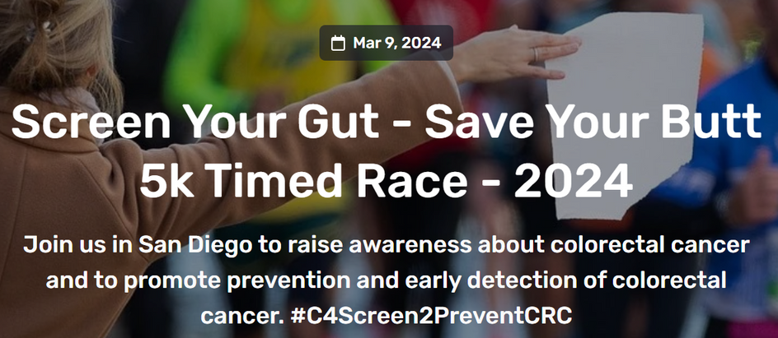

Our Next Steps
You’re Invited!
Get Involved
Stay tuned & sign up! New CRC meeting date coming for fall 2024
Evaluation
Have any feedback? We would appreciate your feedback on today's event - link in the chat!
Date: Saturday, March 9th
Location: De Anza Cove/Mission Bay 2840 N Mission Bay Dr San Diego, CA 92109
Time: 7:30AM
Stay Connected with COE
Follow us on Twitter @UCSDCancer_COE for the latest updates

Slide 49
THANK YOU!
Slides, recording and resources coming soon

